Slide 1
POSSIBLE

Slide 2
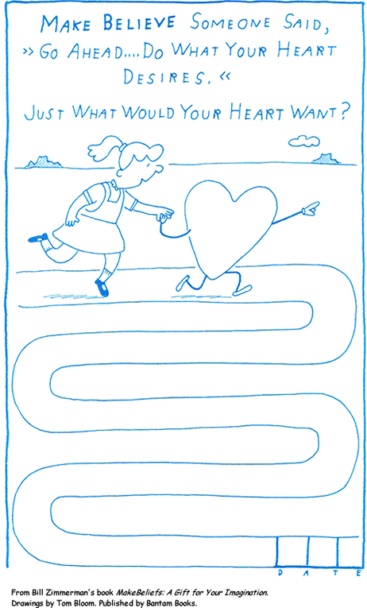

Slide 3
Radical empathy
What impact do I seek to make?
What do I really need? (asking for help)
What am I saying no to? (boundaries to test)
Who do I choose to be?
What am I saying yes to?
How am I talking to myself?
How am I recognising my contribution?

Slide 4

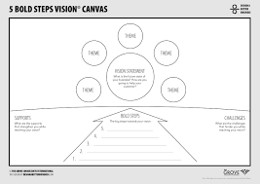
IMPACT - Part 1
How do you want to make a difference?
My Assets
Saying yes to…
Saying no to….
My Narrative - Part 2
People or things that will help me make this impact…
Notes:
Rework this & reframe as My Impact Canvas
>Reference One BIG THING CANVAS from

Slide 5
[Revisit narrative]

Slide 6
Reflection
Based on your understanding of your personal values, assets and priorities, does this cover story shine a light on your assets and boundaries?
Does this narrative serve you in pursuit of your big impact or goal(s)?
Where could you be saying no more?
Who could help you make your impact?
How does it need to be tweaked?

Slide 7
IMPACT - Part 1
How do you want to make a difference?
My Assets
Saying yes to…
Saying no to….
My Narrative - Part 2
People or things that will help me make this impact…
Notes:
Rework this & reframe as My Impact Canvas

Slide 8
Saying no makes space for saying yes to the right things (aligned to our values and priorities)

Slide 9
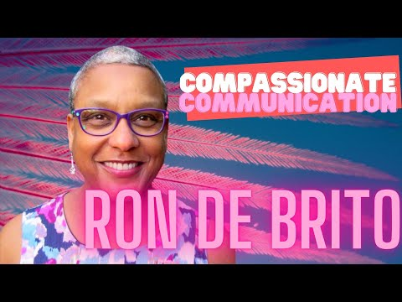

Slide 10
[Iterate narrative]

